Slide 1
Module 2 – Switched Communication Networks Circuit Switching and Packet Switching

Slide 2
Internet as a black box

Slide 3
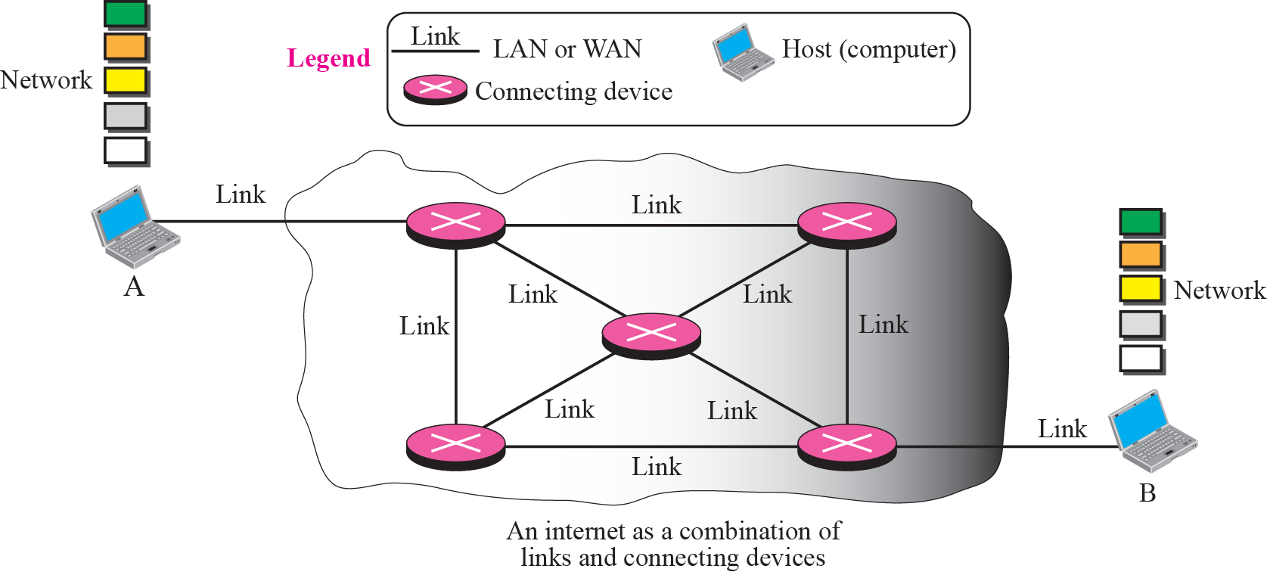
Internet as a combination of LANs and WANs connected together

Slide 4
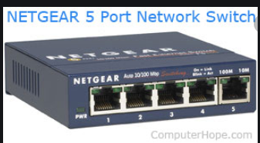
Switched Communications Networks
The passage of a message from a source to a destination involves many decisions. When a message reaches a connecting device, a decision needs to be made to select one of the output ports through which the packet needs to be send out.
Switching is the process to forward packets coming in from one port to a port leading towards the destination. When data comes on a port it is called ingress, and when data leaves a port or goes out it is called egress. A communication system may include number of switches and nodes. Data is then forwarded on that circuit.
A Switched network contains a series of interlinked nodes called switches. These hardware/software devices capable of creating temporary connections between two or more devices linked to the switch but not to each other.
Types of switching to be discuss
Circuit switching
Packet Switching

Slide 5
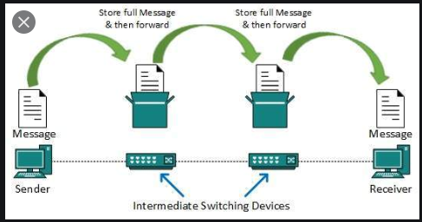

Slide 6
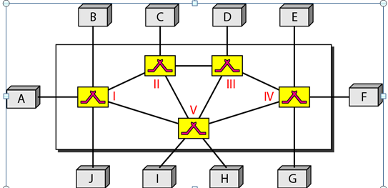
Switched network

Slide 7
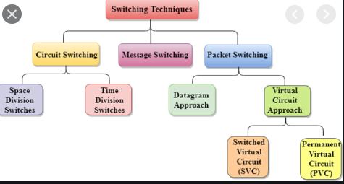
Types of switching
1.Crossbar switches
2.Multistage switches
1.Time slot Interchange
2.TDM bus

Slide 8
Circuit Switching
A circuit-switched network consists of a set of switches connected by physical links. A connection between two stations is a dedicated path made of one or more links. However, each connection uses only one dedicated channel on each link. Each link is normally divided into n channels by using Frequency Division Multiplexing (FDM) or Time division Multiplexing (TDM).
Example
A good example of a circuit-switched network is the early telephone systems in which the path was established between a caller and a callee when the telephone number of the callee was dialed by the caller. When the callee responded to the call, the circuit was established. The voice message could now flow between the two parties, in both directions, while all of the connecting devices maintained the circuit. When the caller or callee hung up, the circuit was disconnected. The telephone network is not totally a circuit-switched network today.

Slide 9
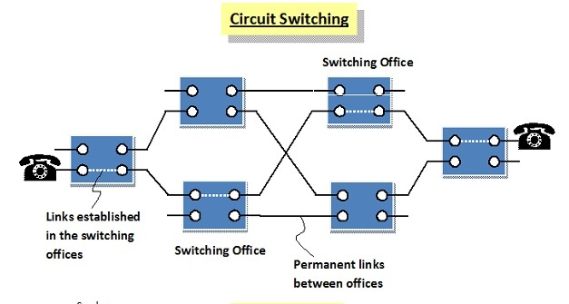

Slide 10
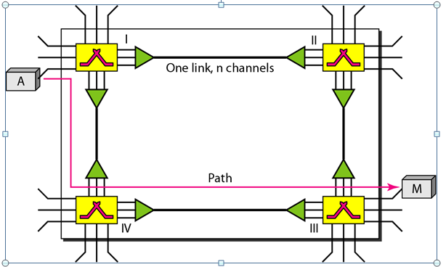
Circuit Switching

Slide 11
Circuit Switching
Circuit switching takes place at the physical layer
Before starting communication, the stations must make a reservation for the resources to be used during the communication.
Data transferred between the two stations are not packetized (physical layer transfer of the signal). The data are a continuous flow sent by the source station and received by the destination station, although there may be periods of silence.
There is no addressing involved during data transfer. The switches route the data based on their occupied band (FDM) or time slot (TDM). Of course, there is end-to-end addressing used during the setup phase.

Slide 12
Circuit Switching- Phases
The actual communication in a circuit-switched network requires three phases: connection setup, data transfer, and connection teardown.
Setup Phase
Data transfer Phase
Tear down Phase

Slide 13
Circuit Switching- Technology in Telephone Networks
The telephone companies have previously chosen the circuit switched approach to switching in the physical layer; today the tendency is moving toward other switching techniques.
For example, the telephone number is used as the global address, and a signaling system (called SS7) is used for the setup and teardown phases.

Slide 14
Types of circuit switching
Space division switches
Crossbar switches
Multistage switches
Time division switches
Time-slot Interchange(TSI)
TDM bus

Slide 15
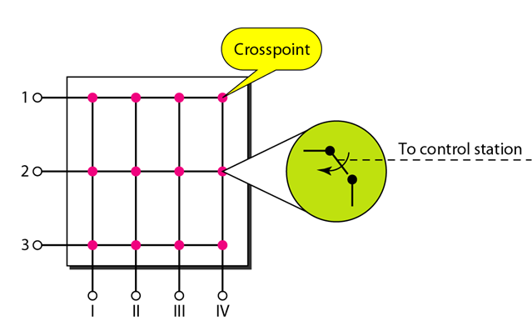
Cross-bar switch
N inputs and M outputs in a grid can connect any input to any output. Connecting N inputs to m outputs using a cross bar switch requires N X M cross points.
Limitations: 25% of crosspoints are only used at a given time.
Transistors
Notes:
Non-blocking: if the output line that you are trying to reach is free, the switch itself should not block the call. In other words, the switch should not block connecting any two free lines (input and output).

Slide 16
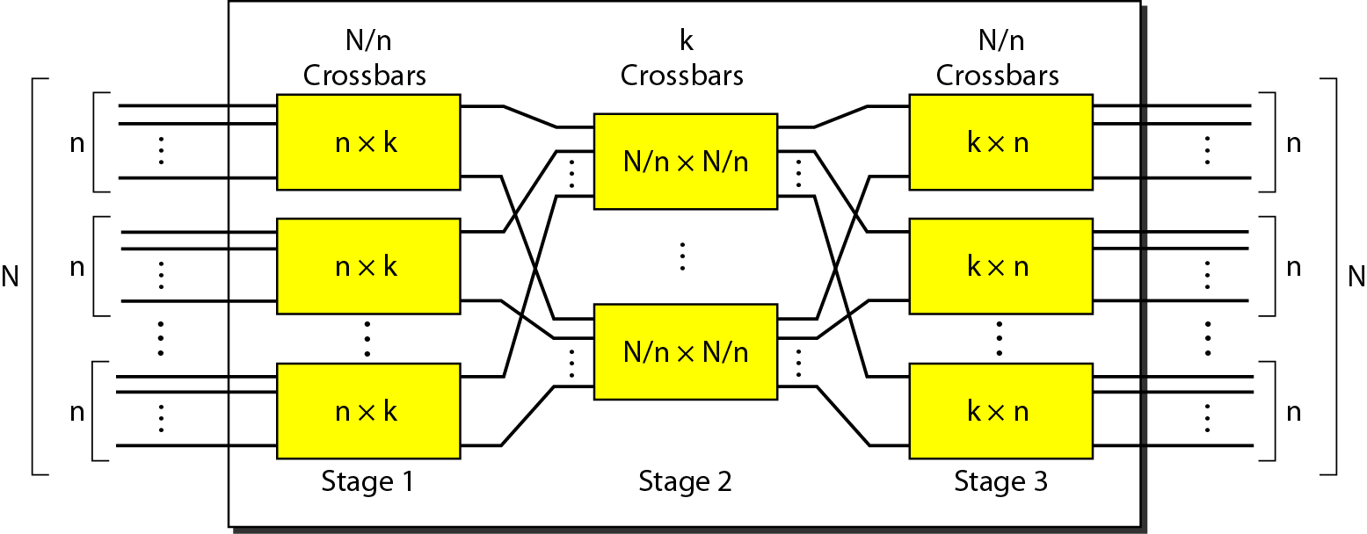
Multistage switch

Slide 17
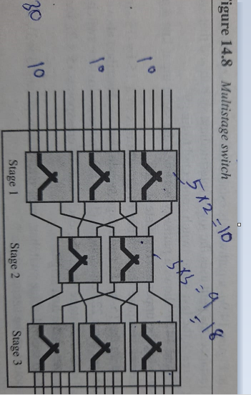

Slide 18
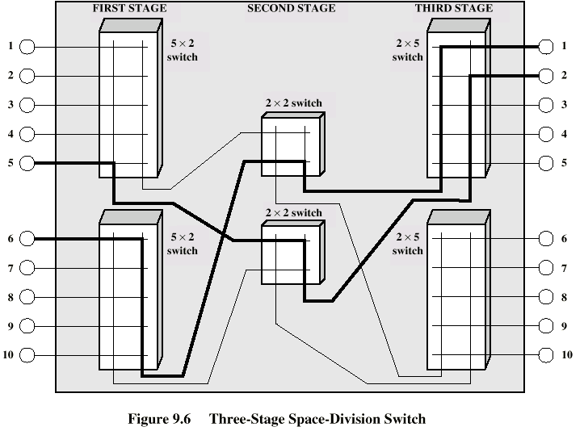
Three Stage Switch

Slide 19
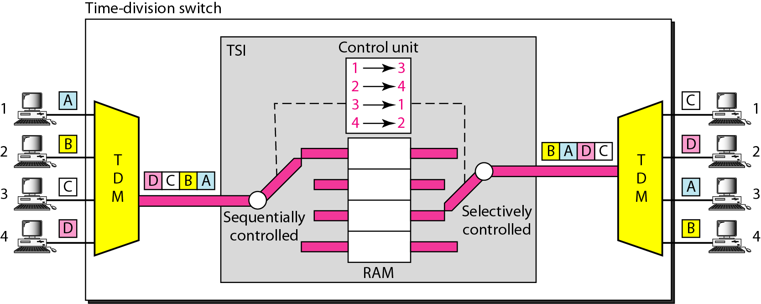
Time-slot interchange

Slide 20
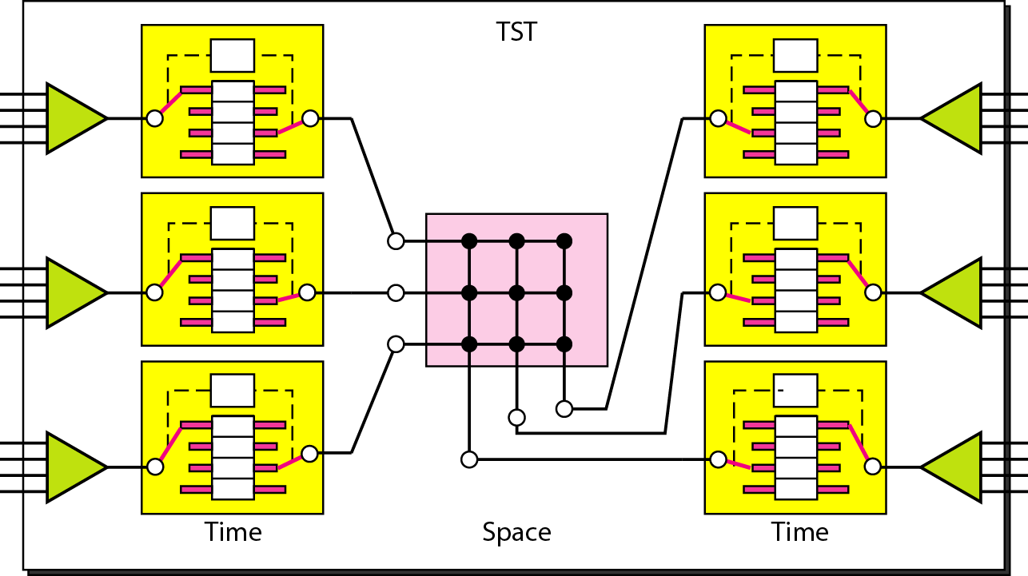
Time Division Multiplexing -switch

Slide 21
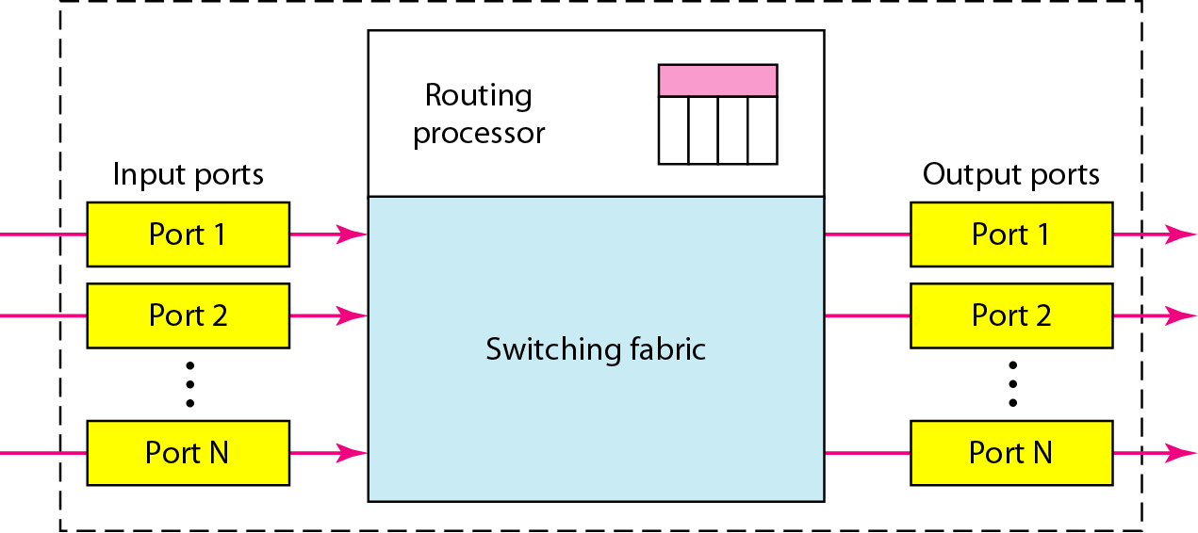
Packet switch components

Slide 22
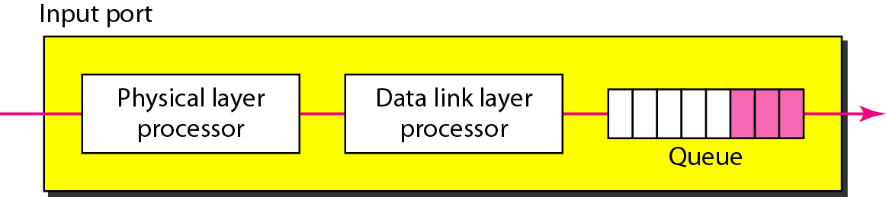
Input port

Slide 23
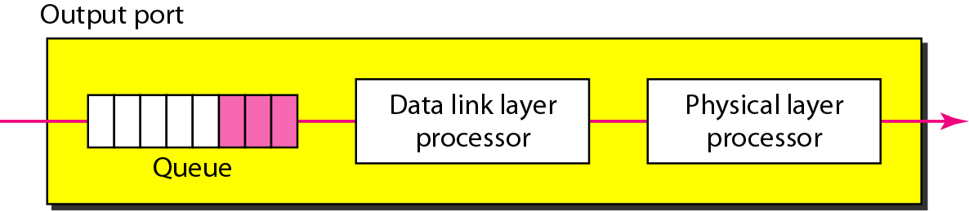
Output port

Slide 24
Packet Switching
Digital networking communications method that groups all transmitted data – regardless of content, type, or structure – into suitably sized blocks, called packets.
Packet switching features delivery of variable-bit-rate data streams (sequences of packets) over a shared network.
When traversing network adapters, switches, routers and other network nodes, packets are buffered and queued, resulting in variable delay and throughput depending on the traffic load in the network.

Slide 25
Packet Switching
Packet switching contrasts with another principal networking paradigm, circuit switching, a method which sets up a limited number of dedicated connections of constant bit rate and constant delay between nodes for exclusive use during the communication session.
In case of traffic fees (as opposed to flat rate), for example in cellular communication services, circuit switching is characterized by a fee per time unit of connection time, even when no data is transferred, while packet switching is characterized by a fee per unit of information.

Slide 26
Example for Packet Switching
The network layer is designed as a packet-switched network.
Individual datagrams are then transferred from the source to the destination.
The received datagrams are assembled at the destination before recreating the original message.
The packet-switched network layer of the Internet was originally designed as a connectionless service, but recently there is a tendency to change this to a connection-oriented service.

Slide 27
Packet Switching

Slide 28
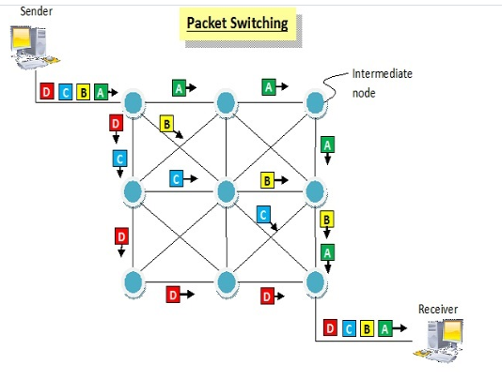

Slide 29
Two major packet switching modes exist
Connectionless packet switching, also known as datagram switching
Connection-oriented packet switching, also known as virtual circuit switching.
In the first case each packet includes complete addressing or routing information. The packets are routed individually, sometimes resulting in different paths and out-of-order delivery. The forwarding decision is based on the destination address of the packet
In the second case a connection is defined and pre allocated in each involved node during a connection phase before any packet is transferred. The forwarding decision is based on the label of the packet.

Slide 30
Connectionless Packet Switching Network

Slide 31
Forwarding Process in Connectionless Network

Slide 32


Delay in Connectionless Network
Notes:
Waiting
time

Slide 33
A Connection Oriented Packet Switched Network

Slide 34
Forwarding Process in a Connection oriented Network

Slide 35
Sending request packet in a virtual-circuit network

Slide 36
Setup acknowledgement in a virtual-circuit network

Slide 37
Flow of one packet in an established virtual circuit
Notes:
14ABData

Slide 38
Delay in a connection-oriented network(Switched virtual network)

Slide 39
Comparison of Circuit Switching and Packet Switching
Parameter | Circuit Switching | Packet Switching
Routing scheme | Route selected during call setup | Each packet routed independently
Multiplexing scheme | Circuit multiplexing | Packet multiplexing shared media access networks
Addressing scheme | Hierarchical numbering plan | Hierarchical address space
Information representation | Analog voice or PCM coded voice | Binary information
End terminal | Telephone, modem | Computer
Transmission system | Analog and digital data over different transmission media | Digital data over different transmission media
Traffic | Real time interactive | Heavy traffic
Application | Telephone network for bi-directional, real time transfer of voice signals | Internet for datagram and reliable stream service between computers

Slide 40
Implementing Network Software
Network architectures and protocol specifications are essential things, but a good blueprint is not enough to explain the phenomenal success of the Internet:
some of the issues involved in implementing a network application on top of the Internet , such programs are simultaneously an application (i.e., designed to interact with users) and a protocol (i.e., communicates with peers across the network).

Slide 41
Implementing Network Software- Application Programming Interface (Sockets)
The place to start when implementing a network application is the interface exported by the network.
Since most network protocols are implemented in software (especially those high in the protocol stack), and nearly all computer systems implement their network protocols as part of the operating system, when we refer to the interface “exported by the network,” we are generally referring to the interface that the OS provides to its networking subsystem. This interface is often called the network application programming interface (API).

Slide 42
Implementing Network Software- Application Programming Interface (Sockets)
The main abstraction of the socket interface, not surprisingly, is the socket. A good way to think of a socket is as the point where a local application process attaches to the network.
The interface defines operations for creating a socket, attaching the socket to the network, sending/ receiving messages through the socket, and closing the socket.

Slide 43
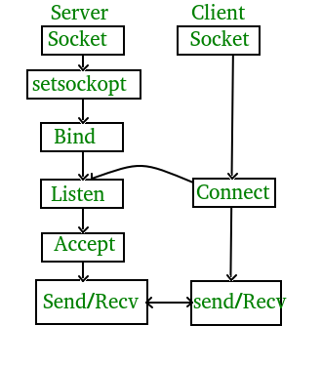
Stage of server and client

Slide 44
Implementing Network Software- Application Programming Interface (Sockets)
Socket creation Steps
Step 1: create a socket, which is done with the following operation:
int socket(int domain, int type, int protocol)
Step 2 : depends on whether you are a client or a server. On a server machine, the application process performs a passive open the server says that it is prepared to accept connections, but it does not actually establish a connection

Slide 45
Implementing Network Software- Application Programming Interface (Sockets)
The server does this by invoking the following three operations:
int bind(int socket, struct sockaddr *address, int addr len)
int listen(int socket, int backlog)
int accept(int socket, struct sockaddr *address, int *addr len)

Slide 46
Implementing Network Software- Application Programming Interface (Sockets)
On the client machine, the application process performs an active open; that is, it says who it wants to communicate with by invoking the following single operation:
int connect(int socket, struct sockaddr *address, int addr len)

Slide 47
Implementing Network Software- Application Programming Interface (Sockets)
Once a connection is established, the application processes invoke the following two operations to send and receive data:
int send(int socket, char *message, int msg len, int flags)
int recv(int socket, char *buffer, int buf len, int flags)
The first operation sends the given message over the specified socket, while the second operation receives a message from the specified socket into the given buffer. Both operations take a set of flags that control certain details of the operation

Slide 48
Networking Parameters(Transmission Impairment, Data Rate and Performance)
Transmission Impairment
Signals travel through transmission media, which are not perfect. The imperfection causes signal impairment. This means that the signal at the beginning of the medium is not the same as the signal at the end of the medium. What is sent is not what is received. Three causes of impairment are attenuation, distortion, and noise

Slide 49
Transmission Impairment - Attenuation
Attenuation means a loss of energy. When a signal, simple or composite, travels through a medium, it loses some of its energy in overcoming the resistance of the medium. That is why a wire carrying electric signals gets warm, if not hot, after a while. Some of the electrical energy in the signal is converted to heat. To compensate for this loss, amplifiers are used to amplify the signal.
Decibel
To show that a signal has lost or gained strength, engineers use the unit of the decibel. The decibel (dB) measures the relative strengths of two signals or one signal at two different points. Note that the decibel is negative if a signal is attenuated and positive if a signal is amplified.

Slide 50
Transmission Impairment - Attenuation
Attenuation means a loss of energy. When a signal, simple or composite, travels through a medium, it loses some of its energy in overcoming the resistance of the medium. That is why a wire carrying electric signals gets warm, if not hot, after a while. Some of the electrical energy in the signal is converted to heat. To compensate for this loss, amplifiers are used to amplify the signal.
Decibel
To show that a signal has lost or gained strength, engineers use the unit of the decibel. The decibel (dB) measures the relative strengths of two signals or one signal at two different points. Note that the decibel is negative if a signal is attenuated and positive if a signal is amplified.

Slide 51
Transmission Impairment - Attenuation
Variables PI and P2 are the powers of a signal at points 1 and 2, respectively.

Slide 52
Transmission Impairment - Attenuation
Example: Suppose a signal travels through a transmission medium and its power is reduced to one-half. Find the attenuation (loss of power).
Output power divided by input power-attenuation
Solution: dB=10 log (P/2P)= -3 dB
Example: A signal travels through an amplifier, and its power is increased 10 times Find the amplification (gain of power).
Solution: dB=10 log (10P/P)= 10 dB

Slide 53
Transmission Impairment - Distortion
Distortion means that the signal changes its form or shape.
Distortion can occur in a composite signal made of different frequencies. Each signal component has its own propagation speed (see the next section) through a medium and, therefore, its own delay in arriving at the final destination. Differences in delay may create a difference in phase if the delay is not exactly the same as the period duration.
In other words, signal components at the receiver have phases different from what they had at the sender. The shape of the composite signal is therefore not the same

Slide 54
Transmission Impairment - Noise
Noise is another cause of impairment. Several types of noise, such as thermal noise, induced noise, crosstalk, and impulse noise, may corrupt the signal. Thermal noise is the random motion of electrons in a wire which creates an extra signal not originally sent by the transmitter. Induced noise comes from sources such as motors and appliances.
To find the theoretical bit rate limit, we need to know the ratio of the signal power to the noise power. The signal-to-noise ratio is defined as:
SNR = average signal power/ average noise power

Slide 55
Transmission Impairment - Noise
Because SNR is the ratio of two powers, it is often described in decibel units, SNRdB, defined as
Log(S/N)

Slide 56
Data Rate
A very important consideration in data communications is how fast we can send data, in bits per second over a channel. Data rate depends on three factors:
The bandwidth available
The level of the signals we use
The quality of the channel (the level of noise) Two theoretical formulas were developed to calculate the data rate: one by Nyquist for a noiseless channel, another by Shannon for a noisy channel.

Slide 57
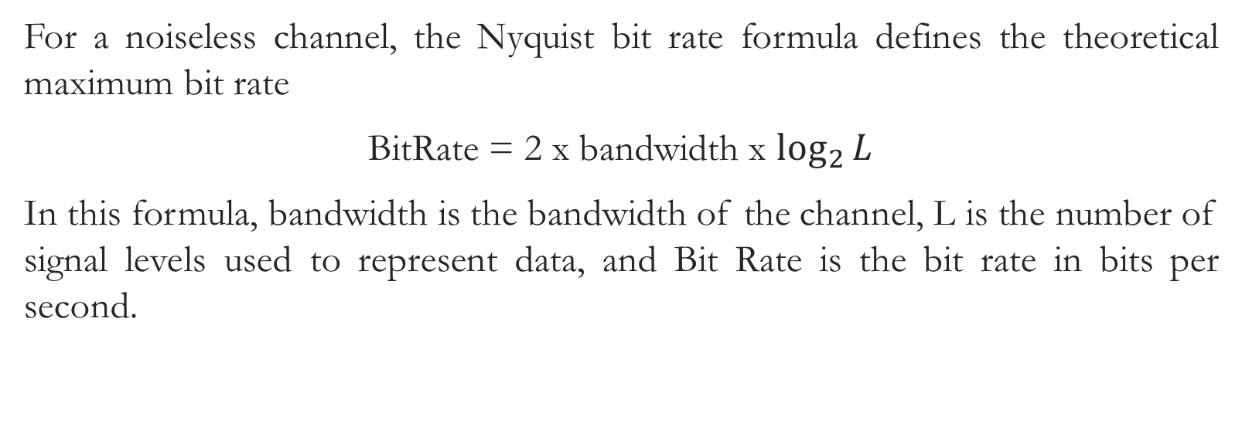
Data Rate - Noiseless Channel: Nyquist Bit Rate
For a noiseless channel, the Nyquist bit rate formula defines the theoretical maximum bit rate
BitRate = 2 x bandwidth x $\log_{2}{L}$
In this formula, bandwidth is the bandwidth of the channel, L is the number of signal levels used to represent data, and Bit Rate is the bit rate in bits per second.

Slide 58
Data Rate - Noiseless Channel: Nyquist Bit Rate
Example:
Consider a noiseless channel with a bandwidth of 3000 Hz transmitting a signal with two signal levels. The maximum bit rate can be calculated as
BitRate =2 x 3000 x log2 2 =6000 bps

Slide 59

Data Rate - Noisy Channel: Shannon Capacity
In reality, we cannot have a noiseless channel; the channel is always noisy. In 1944, Claude Shannon introduced a formula, called the Shannon capacity, to determine the theoretical highest data rate for a noisy channel:
Capacity =bandwidth X $\log_{2}{\text{(1 +}\text{SNR}\text{)} }$
In this formula, bandwidth is the bandwidth of the channel, SNR is the signal-to-noise ratio, and capacity is the capacity of the channel in bits per second. Note that in the Shannon formula there is no indication of the signal level, which means that no matter how many levels we have, we cannot achieve a data rate higher than the capacity of the channel. In other words, the formula defines a characteristic of the channel, not the method of transmission.

Slide 60
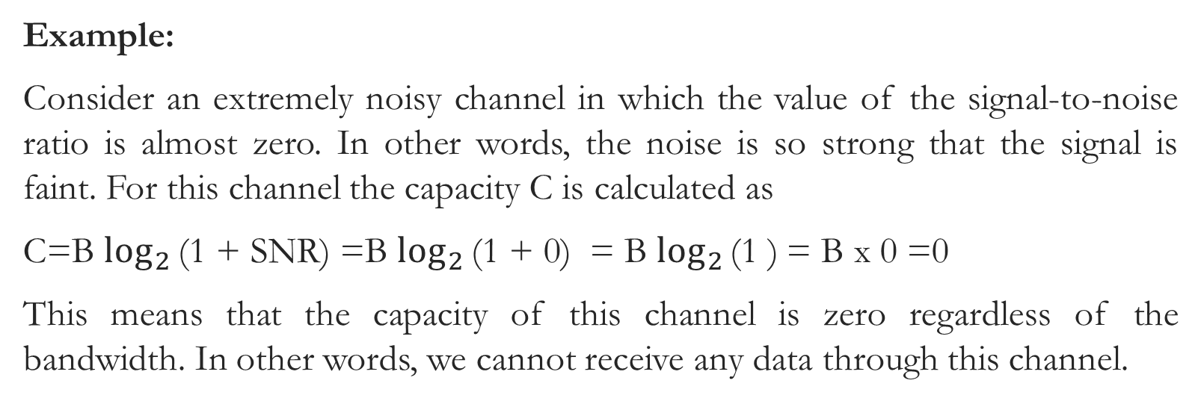
Data Rate - Noisy Channel: Shannon Capacity
Example:
Consider an extremely noisy channel in which the value of the signal-to-noise ratio is almost zero. In other words, the noise is so strong that the signal is faint. For this channel the capacity C is calculated as
C=B $\log_{2}{\text{(1 + }\text{SNR}\text{)}}$ =B $\log_{2}{\text{(1 + }\text{0}\text{)}}$ = B $\log_{2}{\text{(1 )}}$= B x 0 =0
This means that the capacity of this channel is zero regardless of the bandwidth. In other words, we cannot receive any data through this channel.

Slide 61
Thank You

